Slide 1



University Institute of Engineering
DEPARTMENT OF COMPUTER SCIENCE & ENGINEERING
Subject Name: Software Engineering
Subject Code: 23CST-206
Quality Management
Er. Jagmeet Kaur
E8387
ASSISTANT PROFESSOR
CSE
DISCOVER . LEARN . EMPOWER

Slide 2
Chapter-8 Quality Management
ISO 9000

Slide 3
ISO 9000
ISO (International Standards Organization) is a group or consortium of 63 countries established to plan and fosters standardization.
ISO declared its 9000 series of standards in 1987. It serves as a reference for the contract between independent parties.
The ISO 9000 standard determines the guidelines for maintaining a quality system.
The ISO standard mainly addresses operational methods and organizational methods such as responsibilities, reporting, etc.
ISO 9000 defines a set of guidelines for the production process and is not directly concerned about the product itself.

Slide 4
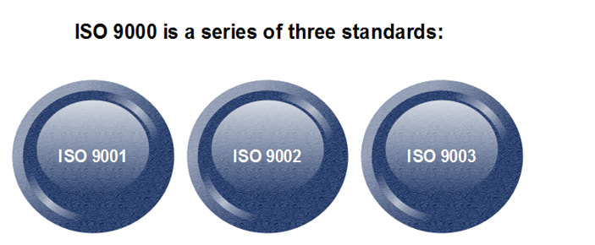
Types of ISO 9000 Quality Standards

Slide 5
Types of ISO 9000 Quality Standards
The ISO 9000 series of standards is based on the assumption that if a proper stage is followed for production, then good quality products are bound to follow automatically. The types of industries to which the various ISO standards apply are as follows.
ISO 9001: This standard applies to the organizations engaged in design, development, production, and servicing of goods. This is the standard that applies to most software development organizations.
.

Slide 6
Types of ISO 9000 Quality Standards
ISO 9002: This standard applies to those organizations which do not design products but are only involved in the production. Examples of these category industries contain steel and car manufacturing industries that buy the product and plants designs from external sources and are engaged in only manufacturing those products. Therefore, ISO 9002 does not apply to software development organizations.
ISO 9003: This standard applies to organizations that are involved only in the installation and testing of the products. For example, Gas companies

Slide 7
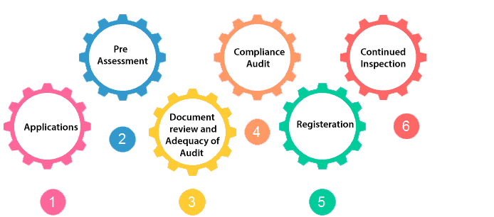
How to get ISO 9000 Certification?
An organization determines to obtain ISO 9000 certification applies to ISO registrar office for registration. The process consists of the following stages:

Slide 8
How to get ISO 9000 Certification?
Application: Once an organization decided to go for ISO certification, it applies to the registrar for registration.
Pre-Assessment: During this stage, the registrar makes a rough assessment of the organization.
Document review and Adequacy of Audit: During this stage, the registrar reviews the document submitted by the organization and suggest an improvement.

Slide 9
How to get ISO 9000 Certification?
Compliance Audit: During this stage, the registrar checks whether the organization has compiled the suggestion made by it during the review or not.
Registration: The Registrar awards the ISO certification after the successful completion of all the phases.
Continued Inspection: The registrar continued to monitor the organization time by time.

Slide 10
ISO 9000 history and revisions: ISO 9000:2000, 2008, and 2015
ISO 9000 was first published in 1987 by the International Organization for Standardization (ISO), a specialized international agency for standardization composed of the national standards bodies of more than 160 countries.
The standards underwent major revisions in 2000 and 2008. The most recent versions of the standard, ISO 9000:2015 and ISO 9001:2015, were published in September 2015.

Slide 11
ISO 9000:2000
ISO 9000:2000 refers to the ISO 9000 update released in the year 2000.
The ISO 9000:2000 revision had five goals:
Meet stakeholder needs
Be usable by all sizes of organizations
Be usable by all sectors
Be simple and clearly understood
Connect quality management system to business processes

Slide 12
ISO 9000:2015 principles of Quality Management
The ISO 9000:2015 and ISO 9001:2015 standards are based on seven quality management principles that senior management can apply to promote organizational improvement.

Slide 13
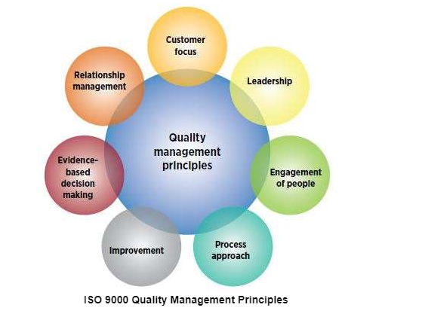

Slide 14
ISO 9000:2015 principles of Quality Management
Customer focus
Understand the needs of existing and future customers
Align organizational objectives with customer needs and expectations
Meet customer requirements
Measure customer satisfaction
Manage customer relationships
Aim to exceed customer expectations

Slide 15
ISO 9000:2015 principles of Quality Management
Leadership
Establish a vision and direction for the organization
Set challenging goals
Model organizational values
Establish trust
Equip and empower employees
Recognize employee contributions

Slide 16
ISO 9000:2015 principles of Quality Management
Engagement of people
Ensure that people’s abilities are used and valued
Make people accountable
Enable participation in continual improvement
Evaluate individual performance
Enable learning and knowledge sharing
Enable open discussion of problems and constraints

Slide 17
ISO 9000:2015 principles of Quality Management
Process approach
Manage activities as processes
Measure the capability of activities
Identify linkages between activities
Prioritize improvement opportunities
Deploy resources effectively

Slide 18
ISO 9000:2015 principles of Quality Management
Improvement
Improve organizational performance and capabilities
Align improvement activities
Empower people to make improvements
Measure improvement consistently
Celebrate improvements

Slide 19
ISO 9000:2015 principles of Quality Management
Evidence-based decision making
Ensure the accessibility of accurate and reliable data
Use appropriate methods to analyze data
Make decisions based on analysis
Balance data analysis with practical experience

Slide 20
ISO 9000:2015 principles of Quality Management
Relationship management
Identify and select suppliers to manage costs, optimize resources, and create value
Establish relationships considering both the short and long term
Share expertise, resources, information, and plans with partners
Collaborate on improvement and development activities
Recognize supplier successes

Slide 21
References
https://www.javatpoint.com/software-engineering-iso-9000-certification
https://asq.org/quality-resources/iso-9000#:~:text=ISO%209000%20is%20defined%20as,to%20organizations%20of%20any%20size.

Slide 22
THANK YOU

